Slide 1
Loneliness: the National picture
Kate Jopling, Independent Consultant
@KateJopling

Slide 2
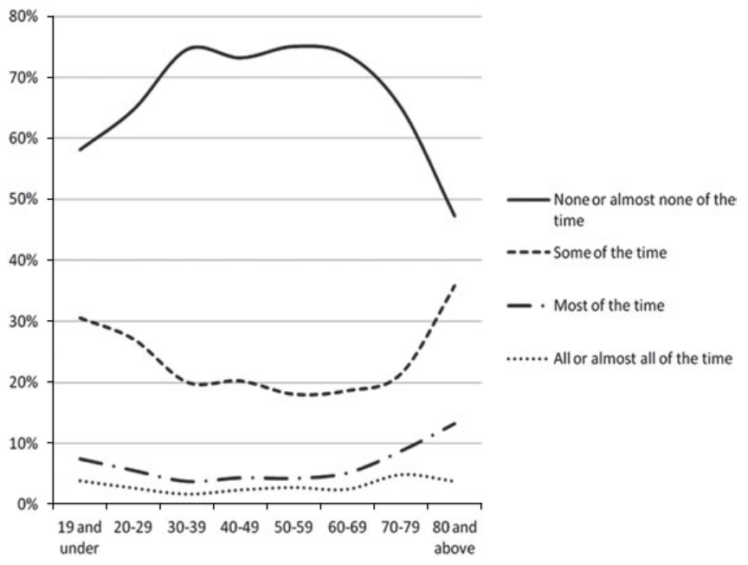
An epidemic of loneliness?
Around 10% of older people (65+) are often or always lonely – consistent over decades
Absolute numbers are growing
Recent surveys suggest younger people are more lonely than older people (but some caution needed)
A U-shaped curve of loneliness through the life course
Source: Yang K. & Victor C. (2011), using data from the European Social Survey
Notes:
https://www.campaigntoendloneliness.org/wp-content/uploads/downloads/2011/07/safeguarding-the-convey_-_a-call-to-action-from-the-campaign-to-end-loneliness.pdf
https://www.campaigntoendloneliness.org/wp-content/uploads/downloads/2012/07/Victor-Loneliness-Plenary-July2012.pdf
https://www.ons.gov.uk/peoplepopulationandcommunity/wellbeing/articles/lonelinesswhatcharacteristicsandcircumstancesareassociatedwithfeelinglonely/2018-04-10

Slide 3
Who is lonely and when?
Growing evidence demonstrating the importance of “life transitions” in loneliness
Changing jobs / becoming unemployed
Becoming a parent / carer
Ill-health
Moving home
Loneliness is understood as an “identity crisis”

Slide 4
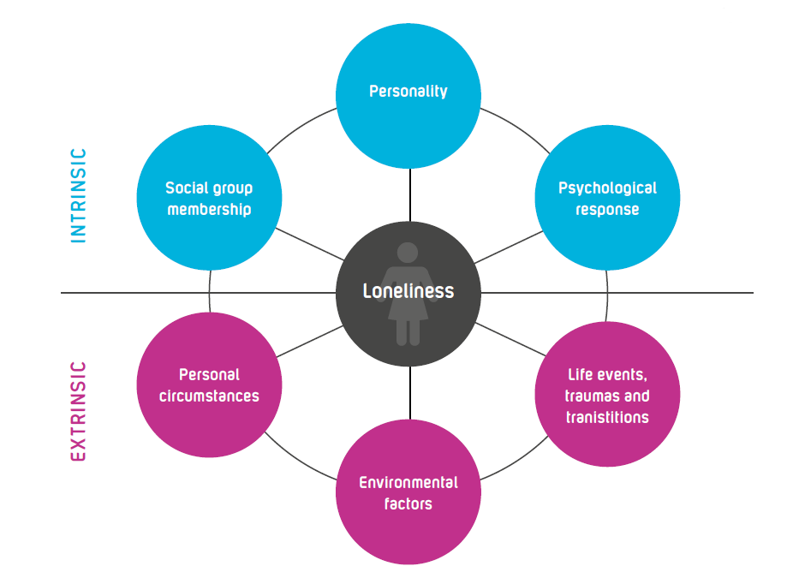
Who is lonely and when?

Slide 5
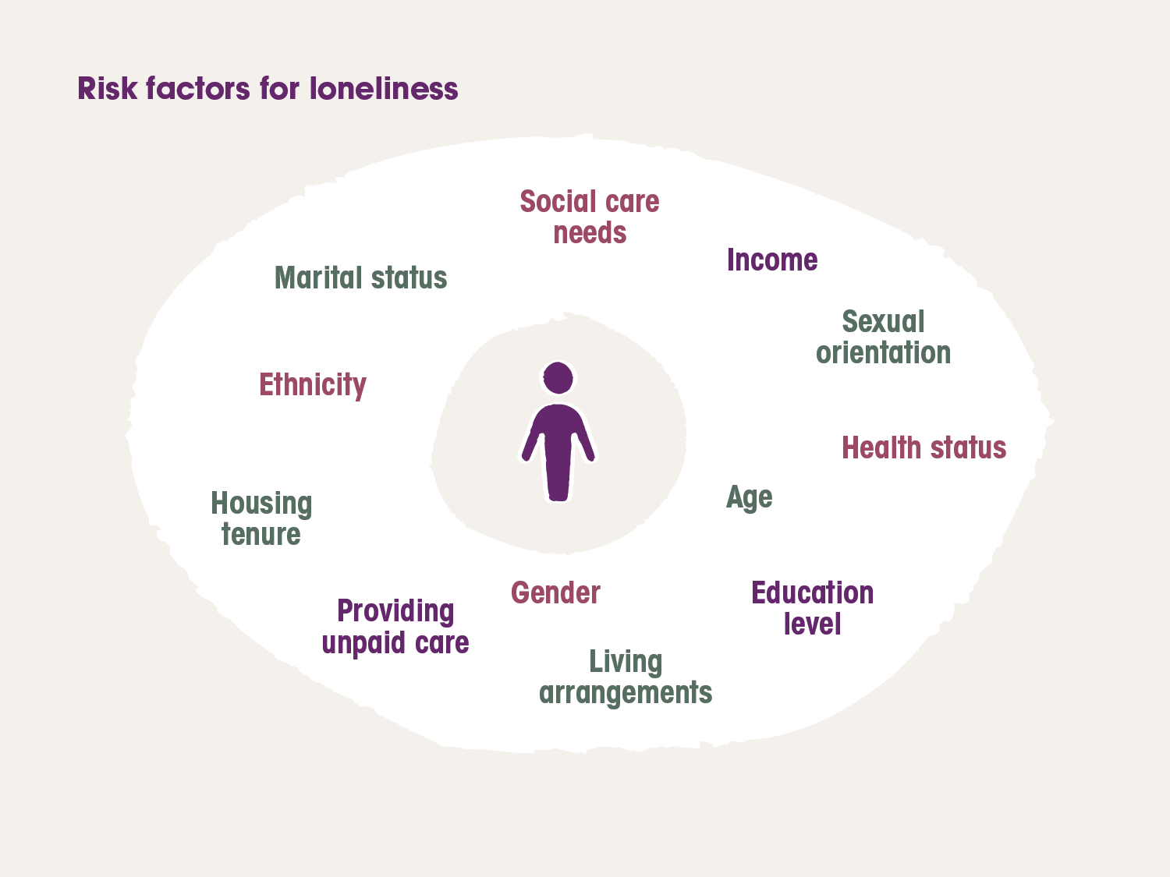
Who is lonely and when?

Slide 6
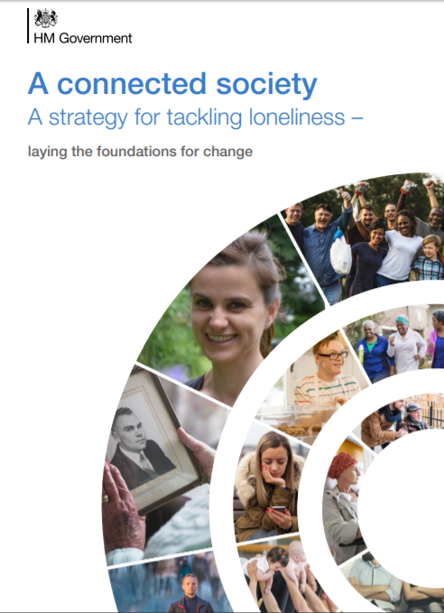
A national strategy
Built on a growing understanding of loneliness as a public health challenge – at local level
Followed the Jo Cox Commission
Launched October 2018
Commitments across every government department including
Rolling out social prescribing
A business network to encourage employers to take action
Planning for a public campaign
Notes:
https://www.campaigntoendloneliness.org/threat-to-health/

Slide 7
Since the strategy…
Loneliness Action Group progress report 2019 – good start but more to do
Lots of small scale actions
A big push on social prescribing in communities (probably the most significant piece)
Early 2020 - All Party Parliamentary Group on Loneliness launched an inquiry – keeping up the pressure

Slide 8
And then…
And then Covid-19 hit…
Recognised connection as a basic need
Response to loneliness as part of the overall response
Deeper understanding and reduced stigma
Huge community response
But
Huge demand on services and reduced funding
Mutual aid and community response – but some myths
£750m for voluntary sector organisations £5m for loneliness specifically
Tackling Loneliness Network

Slide 9
Loneliness in lockdown
Findings from ONS
5% of people in Great Britain experienced chronic loneliness during lockdown - about the same proportion as pre-lockdown.
Significant levels of ‘lockdown loneliness’ particularly among young people (NB this has a specific definition)
Findings from Bu et al
Risk factors for loneliness were near identical prior to and during the pandemic
Heightened risk among those who were already at risk

Slide 10
Loneliness during Covid-19
Bu et al
Young adults
Women
People with lower education or income
The economically inactive
People living alone
Urban residents
ONS
Working-age adults living alone
Those in "bad" or "very bad" health
People in rented accommodation
Single, divorced, separated

Slide 11
Loneliness during Covid-19
Seeing the impacts of differences in expectations
Different experiences e.g. for those who are shielding / those who live alone
New challenges around ill-health and bereavement
Growing mental health challenges
Increasingly experiencing identity shifts

Slide 12
The ties that bind
Evidence suggests that we are sustained not just by our “thick” ties, but also our “thin” ties
Lockdown impacts these thin times in communities – what is happening to our community fabric
We know that places and spaces build these connections – what about when these are disappearing or inaccessible?
Notes:
https://www.campaigntoendloneliness.org/wp-content/uploads/Promising-approaches-to-reducing-loneliness-and-isolation-in-later-life.pdf

Slide 13
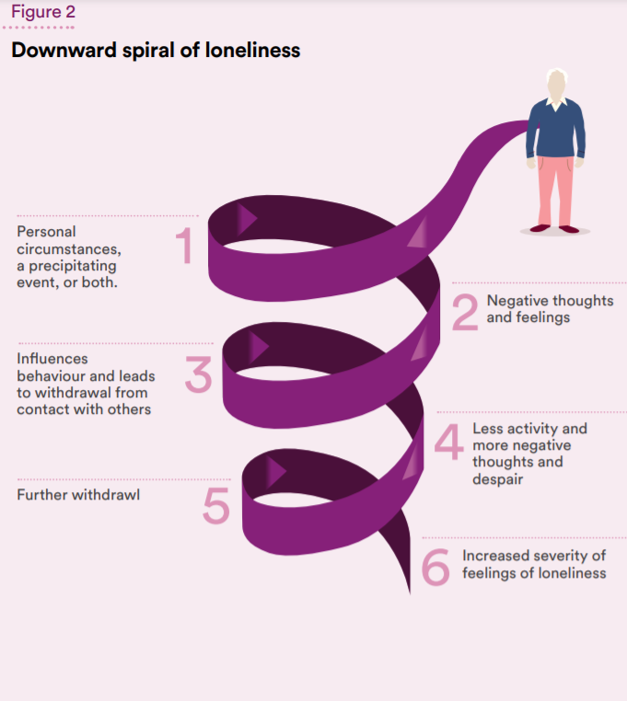
Psychology of loneliness
Loneliness can set us off on a downward spiral of negative emotions
The longer we are lonely the harder it can be to connect
This is not just about a lack of contacts – it’s about how we think and feel about our relationships
Feeling that we do not have a role or purpose or are not wanted can leave us feeling lonely

Slide 14
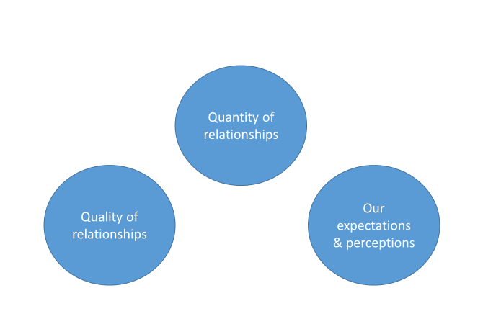
What can we do about loneliness?

Slide 15
Beyond the crisis….
Natural focus on emergency response – checking in, meeting basic needs, a “humanitarian” response to loneliness
But as we move forward
How can we start to offer a more holistic response?
How can we move to supporting relationships – more mutual, more group based, more welcoming ?
How can we involve people rather than support them?
How do we maintain momentum at the national as well as local levels?

