Slide 1
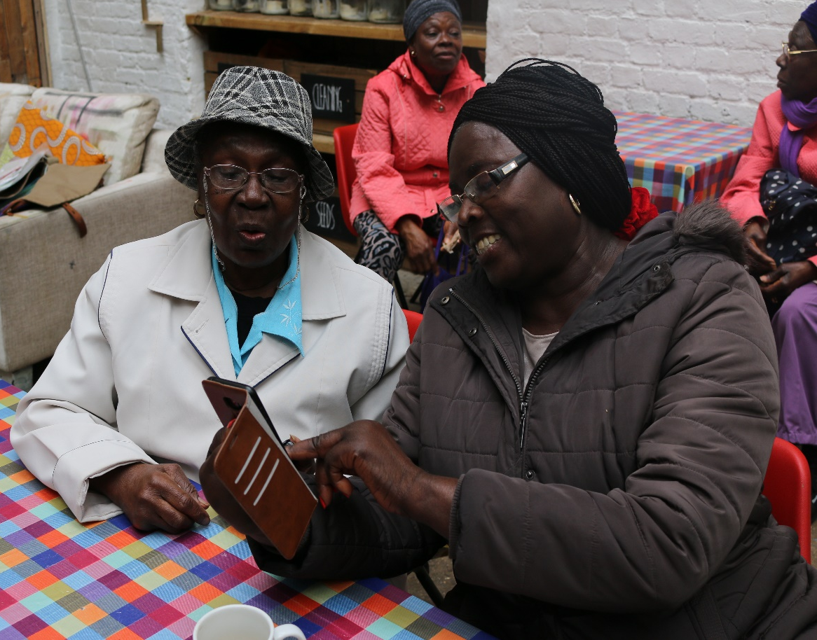
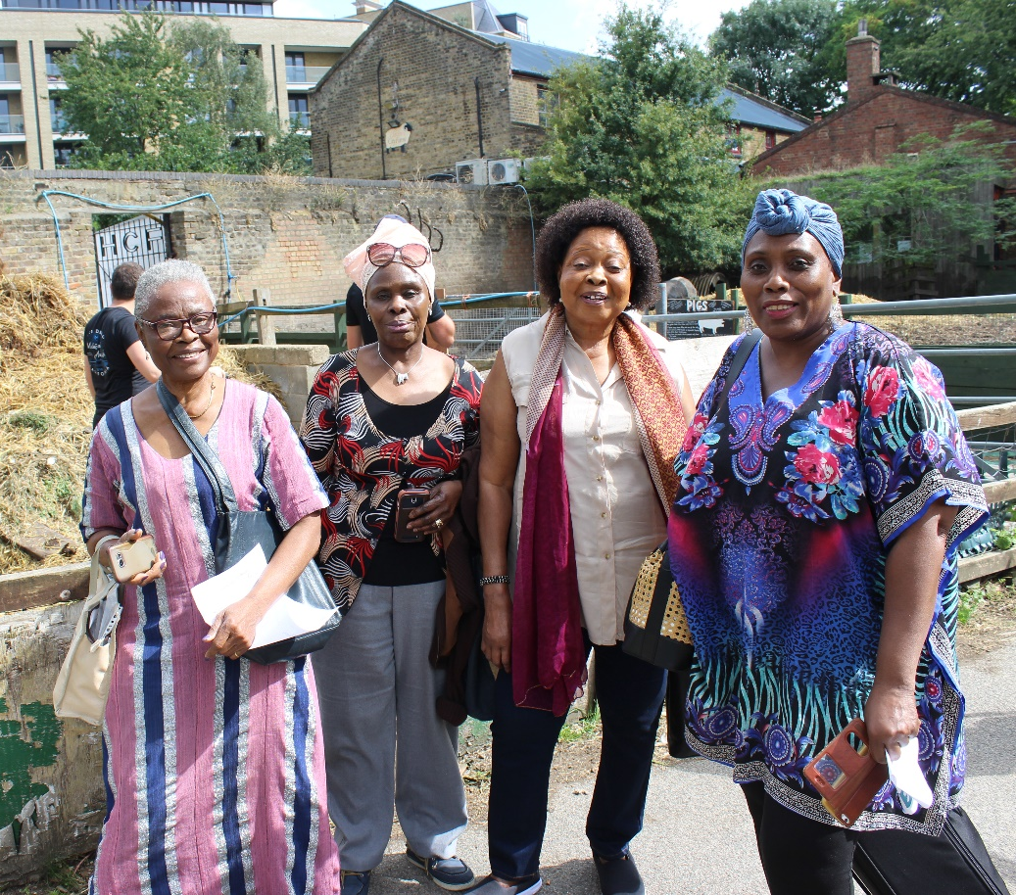
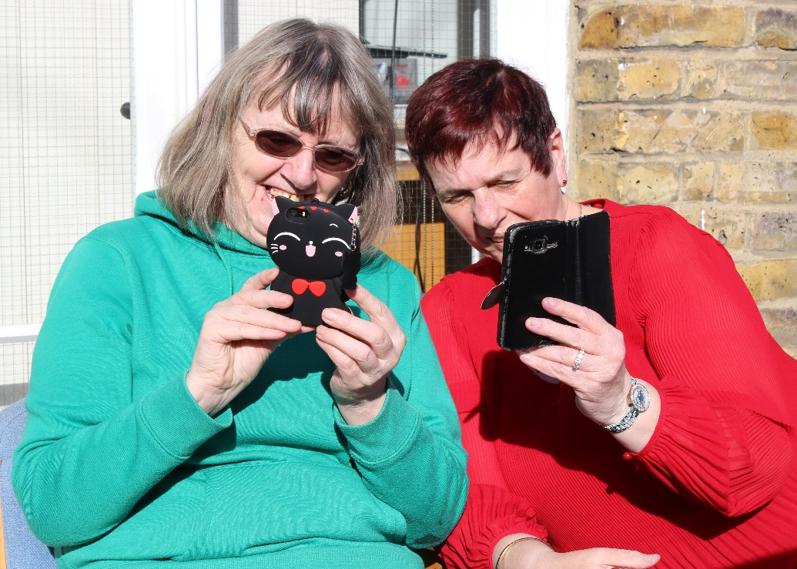
Silver Connections
Connect Hackney Learning Event
26th November 2020

Slide 2
Silver Connections
Silver Connections is an engaging mobile phone course for over 60’s
Simple tips to make their lives easier
Aims to help reduce social isolation
Teaching participants to discover what’s on in their local area

Slide 3
Key Learning
Engagement challenges
Group size and length of sessions
Social connections
Supporting participants with Zoom
Digital exclusion
Differences between devices
Content of the course
Signposting

Slide 4
Case Study - Mary
“I really enjoyed the interaction as it really helps to keep the brain going and it breaks up my day. Before these sessions I felt like I was just existing, but this let me get to know people and brought me out of my shell.”
“I also use Zoom now to do Bible studies. Without Silver Connections I’d never be part of Bible study as I only ever used the iPad for games.”
“I made a friend, who was the person that introduced me to bible studies. She’s from Jamaica and once when I was speaking to her she introduced me to her friends from Barbados. I’ve never travelled because I have a fear of flying, so it was really intriguing for me to meet different people from different countries.”

Slide 5
Participant Feedback
“Very rewarding after finding it difficult to get on”
“You lot are a great laugh - great to be on Zoom and chatting to each other like being back in the class”
“Everything is great, improved my knowledge of my phone, normally I rely on my son and now I can solve most of the problems myself”

