Slide 1
Can the use of technology help to reduce social isolation and loneliness?
An in-depth study of digital inclusion projects for older people before and during the COVID-19 pandemic
Presentation for Ageing Well in Hackney: Finding solutions to older people’s isolation
26th November 2020

Slide 2
Digital exclusion
“How do you find out about your medical condition? How do you register on patient access so you can get repeat prescriptions online or book a GP appointment rather than hanging on the phone for half an hour?”
Project provider
“I'm not very computer literate. I think I learnt when I was about 50 something, so I just want to be able to do more things for myself.”
Project participant

Slide 3
Digital inclusion¹
Helping people become capable of using and benefiting from the internet by:
developing digital skills
improving infrastructure
improving accessibility in digital design
¹ Centre for Ageing Better (2020). How has COVID-19 changed the landscape of digital inclusion? (Online). https://www.ageing-better.org.uk/publications/how-has-covid-19-changed-landscape-digital-inclusion

Slide 4
Connect Hackney digital inclusion projects
 | Silver Connections | @online club
Aims | To build older people’s skills in using smartphones. | To build older people’s skills in using tablet devices
Length of course | 6 weekly 2 hour sessions | 8 weekly 2 hour sessions
Format and delivery | Learning in groups (up to 15) with 2 facilitators | Learning in groups (up to 8) with 4 facilitators (incl. 2 volunteers)
Target group | Over 50s who own mobiles but make little use of them. | Over 60s who want to practice going online using tablets.
Other features | Social outing for group in week 5 Held in the same venue | Taster sessions used for recruitment. Follow-on support via e-newsletter. Held in various venues
COVID-19 adaptations | Groups moved online via Zoom and focused on developing Zoom skills | New telephone helpline offering one to one support

Slide 5
Aims of research
Project reach
Engagement and retention of participants
Impact on participants
Whether impact was sustained over time
Impact of COVID-19

Slide 6
Project reach
Most participants joined with no or very basic digital skills.
The majority of participants were aged 70 and over, female, identified ethnicity as Black or White, and scored higher on social isolation and loneliness measures compared to older Hackney residents in general.
Ongoing pandemic-related social restrictions pose challenges for reaching the most digitally excluded and recruiting new participants.
“I still don’t know the keyboard, so I find it really hard looking for the letters cos I’m not at all sure which line they’re in …”
Project participant
“Unfortunately, there are individuals that we have spoken to that would like to join the course but do not have the means to do so.”
Project provider

Slide 7
Engagement and retention of participants
“Everybody was very kind very nice people and because of their ways they encouraged you to learn and I think because of that I managed to learn quite a lot”
Project participant
Opportunity to learn new digital skills was a key ‘hook’ for engagement
Engagement and retention enhanced by
Personalisation within group sessions
Warm, friendly and social environment
Skilled facilitators
Challenges
Scheduling and remembering to attend sessions
Getting to venues
‘Digital implementation’ barriers
“It’s very hard of course, people at different stages, there was me right at rock bottom and somebody else who would be well away.”
Project participant
“Once you were in the Zoom room, it was lovely to be welcomed, once we were coming in, people would welcome us individually and she would give us time to start.”
Project participant

Slide 8
Perceived impact on participants: confidence and skills
Foundational learning and increased confidence for using digital devices; skills enhanced when able to practice at home
Ongoing assistance and digital infrastructure enhanced continued use of digital devices beyond the short courses
Confidence and skills were retained, and increased, over time
“It’s an accomplishment to me because… I tend to always be self-critical and always say I can’t do something. But the mere fact is I have been able to conquer this. I can manage something, so I feel very chuffed.” Project participant
“I came to update myself or re-learn and I’m so happy I came because I feel somethings now I can manage.” Project participant

Slide 9
Perceived impact on participants: social participation
Digital devices were a new (secondary) way to stay in touch with family, friends and community networks.
Attending the course itself was a way to increase social participation and establish new social connections.
With the onset of COVID-19, being able to socially connect online became a new motivator for joining the digital courses.
“It has been a boost for me to have something to look forward to weekly, and something which I have learnt from, apart from seeing the friendly faces of the tutors, is the rest of the group.”
Project participant
“As a matter of fact it was a family celebration that the relatives were doing on Zoom and I became frustrated to tears that I wasn’t able to take part.”
Project Participant

Slide 10
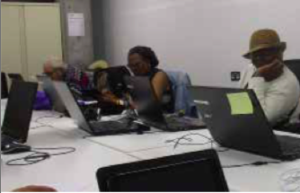
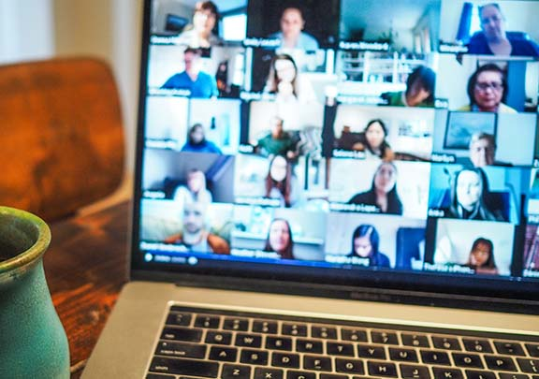
Conclusions
Group-based digital inclusion projects can help older people to learn new digital skills and feel more socially connected.
Regardless of mode of delivery, this study has identified a number of success factors.
Future activities during ongoing social restrictions should balance provision of remote groups with reaching the most digitally excluded.
Action to develop older people’s digital skills needs to be supported with action to address digital infrastructure and digital design.

Slide 11
Thank you!
This presentation is based on the forthcoming report which will be available on the Connect Hackney website by March 2021:
Herlitz L and Harden A (2021) An in-depth study of digital inclusion projects for older people living with, or at risk of, social isolation and loneliness before and during the COVID-19 pandemic
Our interim report is available online at:
https://www.connecthackney.org.uk/wp-content/uploads/2020/11/Connect-Hackney-Digital-inclusion-projects.pdf

