Slide 1
Co-production, partnership working and system change
Learning from the evaluation so far and next steps
Presentation for Ageing Well in Hackney: Finding solutions to older people’s isolation
26th November 2020

Slide 2
Connect Hackney programme evaluation highlights
Reached more than 4,000 older people
Participants are diverse and include groups that are underserved by services
Programme is reaching those who are already lonely as well as those at risk

Slide 3
*Loneliness measured on the UCLA scale scored on 3 items: 1. How often do you feel left out? 2. How often do you feel isolated from others? 3. How often do you feel in tune with the people around you?

Slide 4
Connect Hackney programme evaluation highlights
Reached more than 4,000 older people
Participants are diverse and include groups that are underserved by services
Programme is reaching those who are already lonely as well as those at risk
“Talking to someone who shows an interest and cares. That’s a big deal you know. It makes you feel human again. Makes you feel you’ve got something to offer, you’re not over the hill”
(Connect Hackney community connector project participant)

Slide 5
Connect Hackney programme as an anchor within the pandemic
Helping to support adaptation of existing routines and development of new ones.
A social network to check in, share and ‘belong’.
Someone familiar to turn to for help.
“Before lockdown I had a very sort of erm, strict routine which kept me, erm, I suppose like balanced.…so when lockdown happened it really threw me …like just a terrible panic, it was like my whole life, all that routine that kept me mentally well just stopped.….But then with [the project] its been a life saver.” (Complex needs project participant)
“The friends that you meet there, we played dominoes together at the club. I contact them, we contact each other, find out how we’re doing and so on.” (Community Activities project participant )
“I might not know who to turn to and where to go for help, because I don’t know, you know when you’re not well, your mind is blank..……I’m very glad that I know the [name of project] before all this lockdown. I feel I’m very lucky.” (Men’s project participant)

Slide 6
Co-production and partnership working
Co-production refers to the process of citizens and professionals working together in an equal and reciprocal relationship to achieve common goals. Enhancing the skills and knowledge of both parties, adding value through the generation of long-term assets (individual, organisational and community), new insights, and social relations
(Salisbury, 2020)

Slide 7
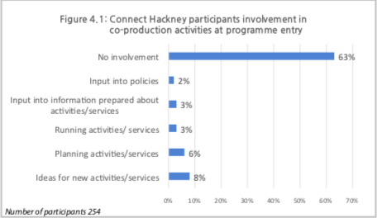

Slide 8
Working in partnership with older people
Connect Hackney Older People’s Committee
Influenced the the working practices of the central Connect Hackney team
Influenced the commissioning, and through this the design and implementation, of the programme

Slide 9
Co-production during the pandemic
“I got one lady….she is making them the masks…….And she show us how to make them, she put a video how to make, how to cut, how to sew and most of them are doing.” (Ethically Diverse Groups project provider)
“Before Covid, some [participants] were not that vocal but when we started the WhatsApp calls, they were so vocal all because they were in the comfort of their family homes and all that.” (Complex Needs project provider)
Examples of co-production and asset-based working not just being maintained but enhanced.
“We need to be close to the other people …its therapeutic because we’re trying to avoid the stress you know. It’s important that we [are] changing our thoughts with the others…because sometimes when there’s all sorts of things in our heads we start talking about it and it became [smaller] than they really were. So this is why I consider this erm, zoom meeting very important because….we continue we are, we don’t feel alone we know that we’re not alone”
(Ethically Diverse Groups project participant)

Slide 10
Further evaluation of co-production
T&L Question | Data and analysis
What have we learnt about the contributions that older people make to the local community through volunteering or informal community involvement? | *Analysis of relevant data from competed provider and participant interviews *New interviews with OPC members and Hackney Senior volunteers *Analysis of data on volunteering and co-production from participant survey
How have asset-based community development approaches been effectively used?
Notes:
Today will

Slide 11
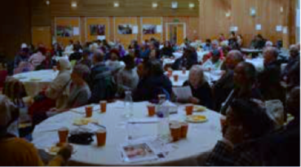
Whole systems change
A system is a collection of interdependent and interconnected parts. If something happens to one part of the system, other parts of the system will be affected.
A local whole systems approach enables local stakeholders, including communities, to come together, share understanding of the challenges, consider how the local system is operating and the opportunities for change.
Stakeholders agree actions and decide how to work together in an integrated way to bring about sustainable, long term systems change.

Slide 12
Evaluating whole system change
Test and Learn Questions | Data
How has/could system change been influenced/be influenced, as a result of the Connect Hackney programme? | *Analysis of relevant data from competed provider and participant interviews *New interviews with the Connect Hackney programme team and external stakeholders
How could what works well in the projects be sustained/scaled up after funding for Connect Hackney ends?
Notes:
Today will

Slide 13
Conclusion
The findings of the evaluation so far have provided evidence on:
How to reach, engage and retain diverse and underserved groups of older people in projects to reduce social isolation and loneliness;
The perceived impact of projects on older people;
Initial findings on the processes needed to facilitate good quality co-production.
The impact of COVID-19
Current analysis and our next steps will:
Assess the extent of changes in quantitative measures of social isolation and loneliness
Deepen understanding of the characteristics of effective elements of the programme
Unpack and track system change in line with the legacy objectives of the programme

